Slide 1

Intro – Python

Slide 2
Introduction
Introduction to Python
Why Python?
Facts and versions of python
Various Libraries
Code compilation process
Installation and IDEs
First Python Program
Python Basics
Data Types
Arithmetic operations
Logical Operations
Variables
I/O Program
Python Basics – cont
Conditional statements
If – else
If – elif – else
Nested if – else
Loops
For Loop
While Loop
Nested Loop
Control Flows
Brake
Continue
Pass
String Manipulations
Accessing String, Basic Operations & String Slicing

Slide 3
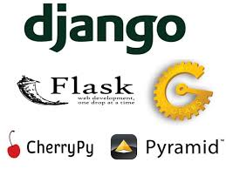
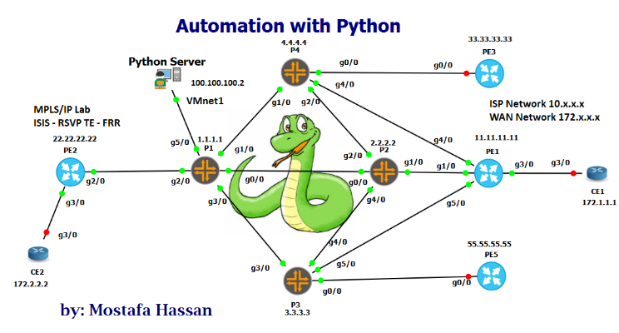
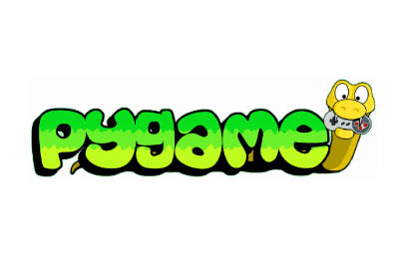

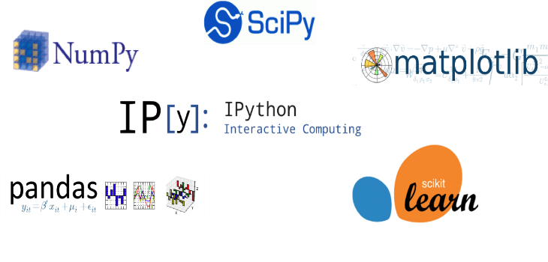
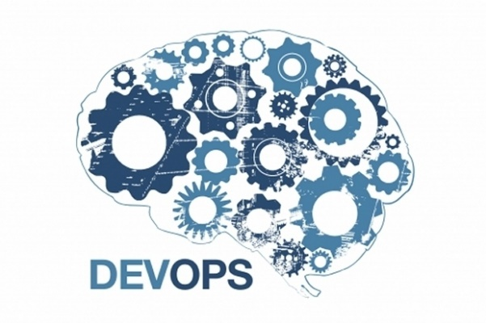
Why Python?
Web App Development
Network management Systems
Python For Gamming
Text Mining or Sentiment Analysis
Data Science
DevOps Scripts

Slide 4
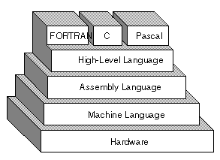
Intro - Python
Python is a powerful high-level, Object-oriented language created by Guido Van Rossum
Features of Python
Simple and Easy to Learn
Free & open source
Portability
High Level, interpreter language.
Extensibility: can be easily extensible with other languages.
Huge libraries with Community support
Object Oriented

Slide 5
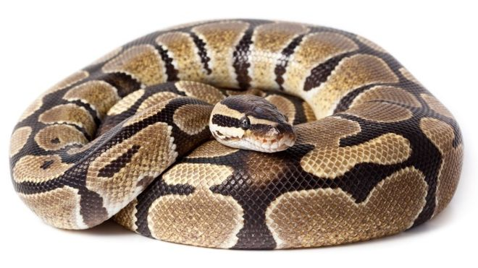
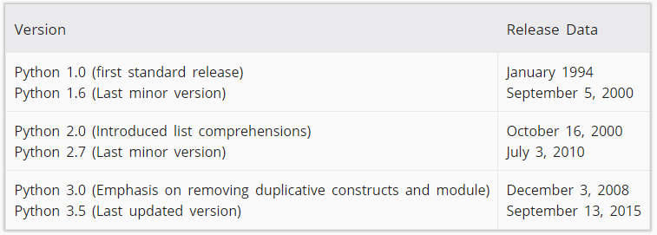
Facts of python
Rossum was fan of a comedy series from late 1970’s. The name "Python" was adopted from the series "Monty Python's Flying Circus"

Slide 6
Installation & IDE
Mac
https://docs.python.org/3/using/mac.html#getting-and-installing-macpython
https://www.python.org/downloads/mac-osx/
Linux/Ubuntu
https://www.python.org/downloads/source/
Windows
https://www.python.org/downloads/
IDE (Integrated Development Environment)
Python IDE
PyCharm (JetBrains)
Sublime Text
Atom (Google’s IDE)
First Program Hello World

Slide 7
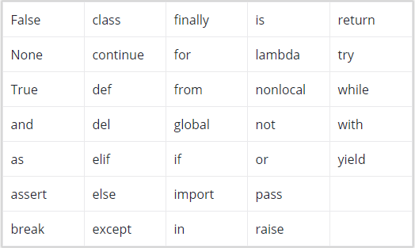
Keywords & Variables
Keywords: reserved words of python
Key words cant be used for
variable name
Function name or any other identifiers
Python keywords are case sensitive
Python has 33 keywords
Most of the keywords are in lower case except (True, False & None)
Variables are the place holder for any data type.
Rules for Variable names
It can be combination of letters in lowercase (a-z) and upper case (A-Z) or with underscore ( _ )
It cannot start with digit
Keywords cant be used as identifiers or variables
It cannot have special characters (!, @, #, $, % etc)

Slide 8
Comments & Indentation
Comments
Single Line: #
Multiple line: ‘‘‘ ’’’
Indentation: C, C++, Java uses {} for a block of code. But python uses indentation a proper space styling method.
Code block start with indentation and ends without indentations.

Slide 9
Assignment – 1
Difference between high level language and low level language.
What is the difference between python 2.7 & python 3.6 ?
Create at least 5 variables that are valid
Create at least 5 variable that are not valid
Try out assigning variable names with keywords and give the results, specify the error if any
Try out Single line comment & multiple Line comment.

